Slide 1
ASCE Steel Bridge Competition
By: Sean carroll, william castore,
kim dana, eric humcke, brian litt

Slide 2
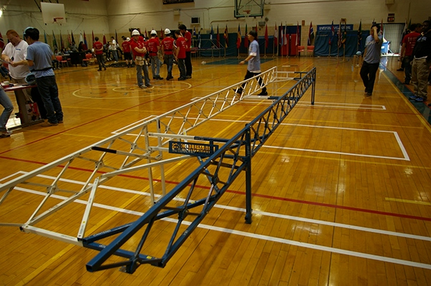
What Is Steel Bridge?
National design competition
20’ Steel bridge
Adhere to specified rules
Most cost effective bridge
Weight
Aggregate deflection
Construction time

Slide 3
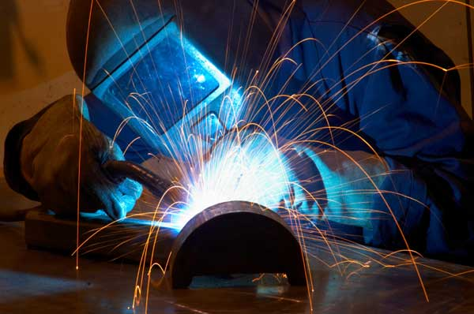
Constraints
Money
Realistic: Fundraising efforts
Design: Total cost
Time
Realistic: Fabrication process
Design: 30 mins to construct
Fabrication
Realistic: Welding skills, machine limitations
Notes:
To build the bridge, realistic and design constraints for money, time, and fabrication were considered.
For money, the realistic constraint is the amount of fundraising money we can accumulate. Sean will discuss our success later on in the presentation. The design constraint for money takes into account the total cost which includes number of workers, weight of the bridge, and aggregate deflection.
The next constraint is time. The realistic time constraint is that we only have certain amount of hours to compete the fabrication process before competition. For the design time constraint, during competition, the time allotted to construct the bridge is 30 minutes without being penalized and 45 minutes before construction is halted.
The third constraint is fabrication. Since we are welding the members in houseBecause we are not able to fundraise enough money to have our parts professionally manufactured and we are not proficient welders or have the machines to do so, we are limited to the design we can fabricate. For example, as a group, we presented Brian's connection design as seen in the picture for the same bridge design discussed before. Joe explained the difficulty in welding the connection due to the amount of precision needed to have 3 members connect.
Eric will elaborate on the total cost for each bridge design through the application of a decision matrix later on. As a group we presented one of our top designs to Machinist Joe Zanetti, who gave his concerns with the amount of triangles we planned on using. He explained it would take double the amount of hours as last year's bridge and since we would like to test our bridge before competition, there most likely is not a sufficient amount of time.

Slide 4
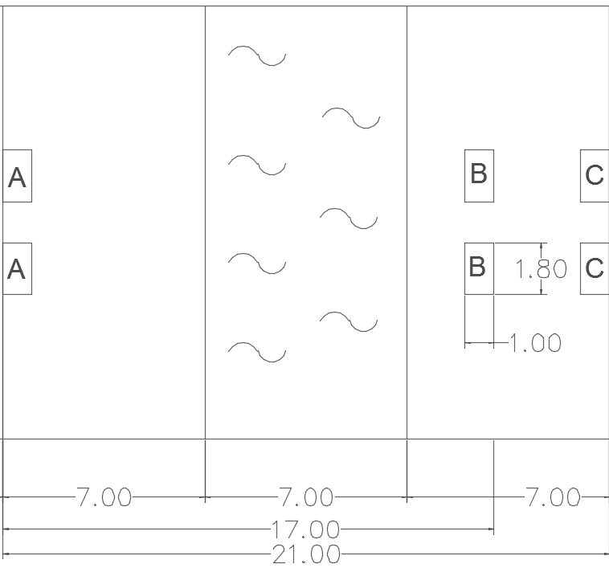
Site Layout Plan
Construction Zone
Construction Zone
River
Notes:
Here you can see the various zones for staging, transportation, and construction. As Brian mentioned earlier, the bridge needs to be a 20 feet in order to fit within the constraints.

Slide 5
Vehicle Profile
Notes:
Here is a picture of the vehicle profile, the bridge must fit within the hatching portion.

Slide 6
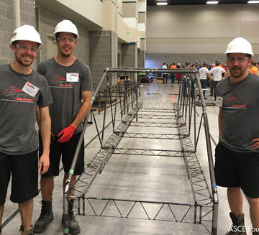
Research
Attended 2016 regional competition
Watched construction videos
5 per member
Results from 2016 Nationals
< 200 lbs
< 10 mins
< 1 inch
2016 National Steel Bridge Competition Winners
Notes:
Before diving into the design stage, we each evaluated 5 previous steel bridge teams and determined the advantages and disadvantages of each. Based on the research, we determined that having 4 builders and a temporary pier is the most ideal. Additionally, we reviewed the results from the 2016 Nationals competition to determine the values we would need for our bridge to be competitive. The bridge would need to be under 200 pounds, constructed around 10 minutes, and deflect minimally.
Although some teams chose to use 3 members and were successful, having the additional builder would cut down on the time to construct, thus lowering the construction cost.

Slide 7
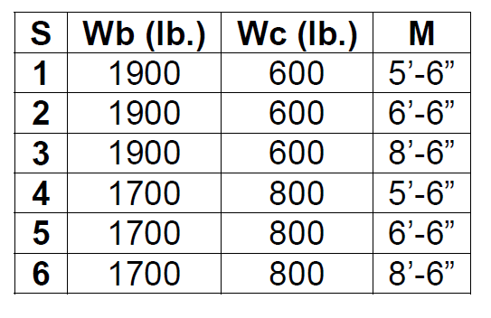
Visual Analysis
Program that computes structural member values
Six different possible load combinations

Slide 8
Visual Analysis
1.9 Kips
0.6 Kips
6 ½ Ft
3 Ft
(typ.)
Visual Analysis Moment Diagram

Slide 9
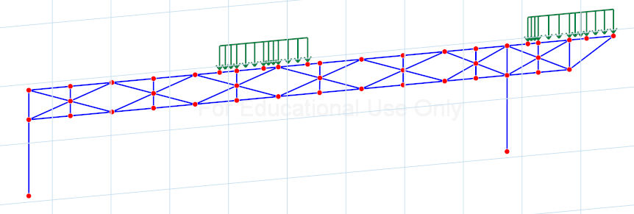
Visual Analysis
Alternative Design 1 (Eric)
160 lbs
Aggregate Deflection = 0.64”
Alternative Design 2 (Kim)
200 lbs
Aggregate Deflection = 0.52”

Slide 10
Visual Analysis
Alternative Design 3 (Billy)
170 lbs
Aggregate Deflection = 2.27”
Alternative Design 4 (Sean)
186 lbs
Aggregate Deflection = 0.86”

Slide 11
Visual Analysis

Slide 12
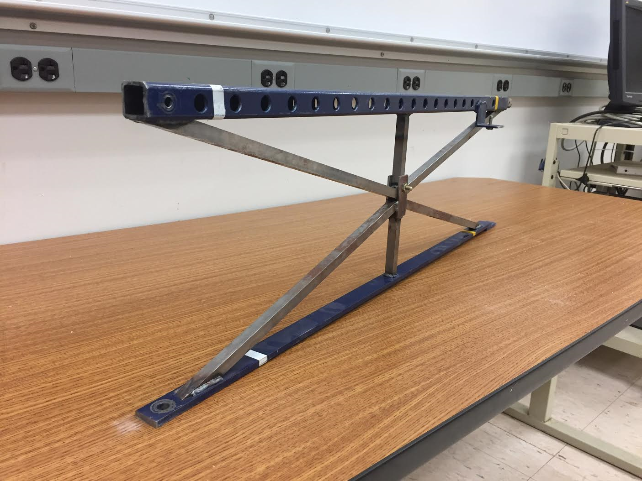
Material Variation
1) Decking: Box Tubing
Withstand compressive forces while maintaining low weight
2) Bottom of Truss: Rectangular Flat Bars
Withstand tensile forces
3) Within Truss: Solid Square Bars
Withstand moderate tensile and compressive forces

Slide 13
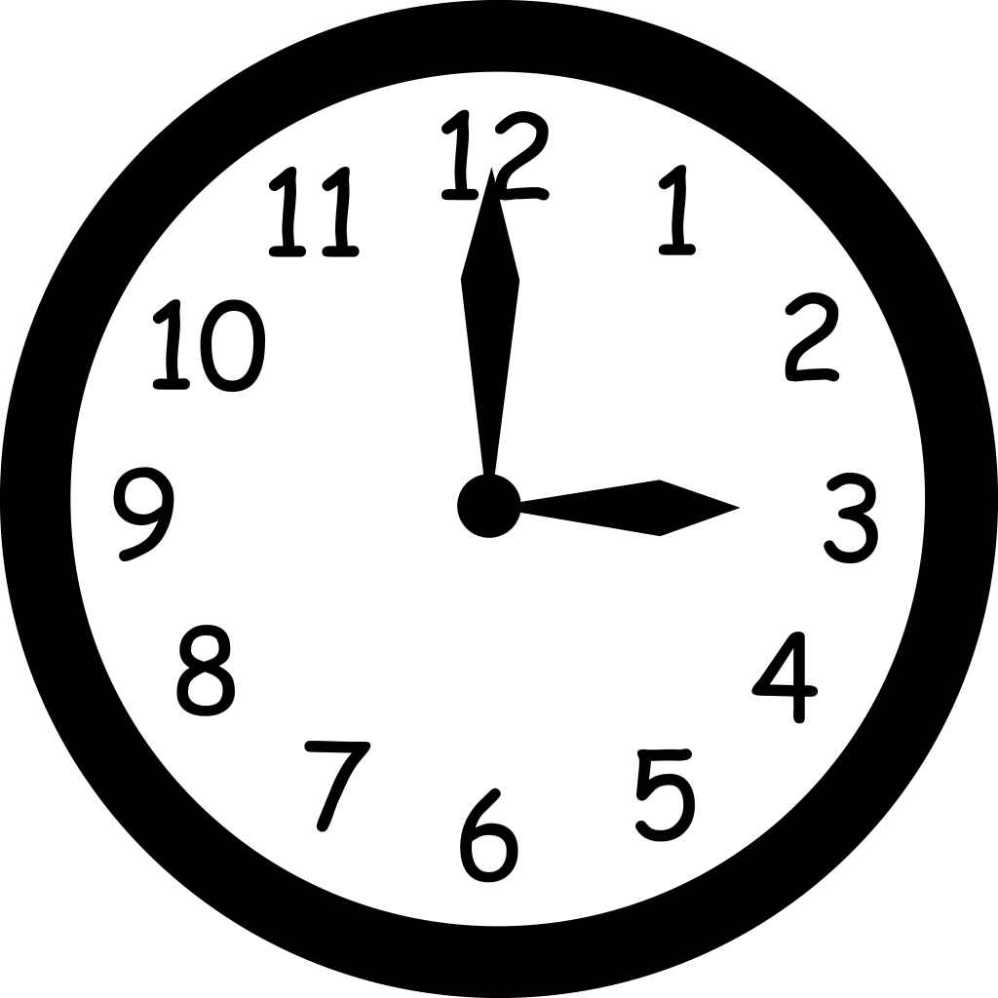
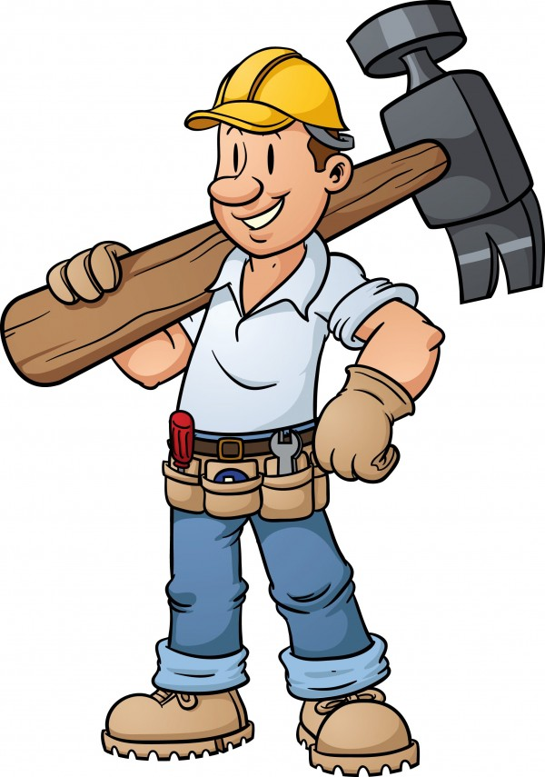
Decision Matrix
Construction Economy
(minutes) x (number) x $50,000 = Cc
Structural Efficiency
(pounds) x $10,000 +
(inches) x $1,000,000 = Cs

Slide 14
Decision Matrix

Slide 15
Design Selection
Eric’s Design
Kim’s Design – Final Design Selection
Fewer connections
Simpler fabrication process
Less deflection

Slide 16
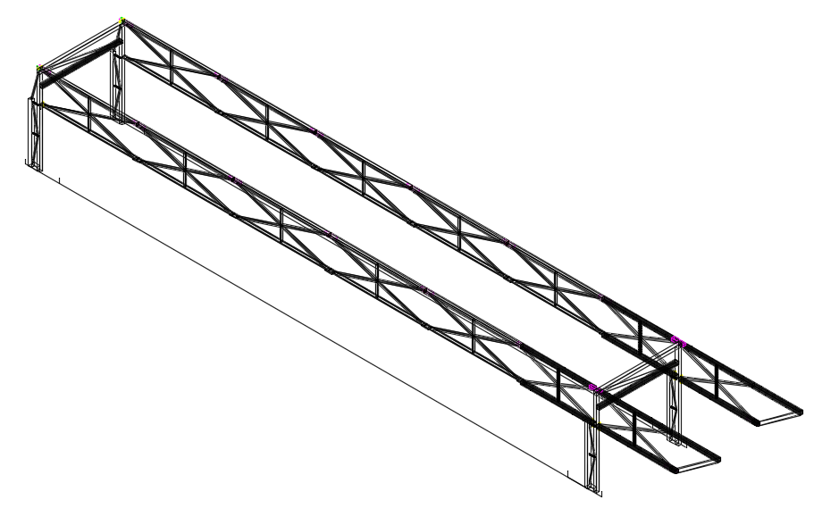
3D Modeling
Connections
Supports
Notes:
3D modeling was completed in both Visual Analysis and AutoCAD. Modeling was done in both because it created an easy way to determine dimensions using AutoCAD helping with Shop drawings, while Visual Analysis shows the reaction of the design due to the loading.

Slide 17
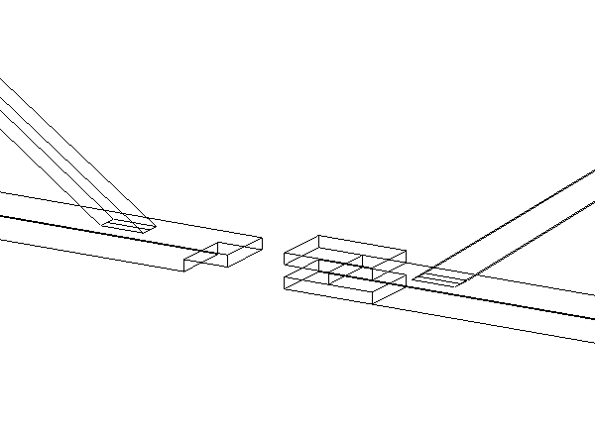
Connections
Notes:
TAKE SNIPS OF CONNECTIONS FROM CAD FILES

Slide 18
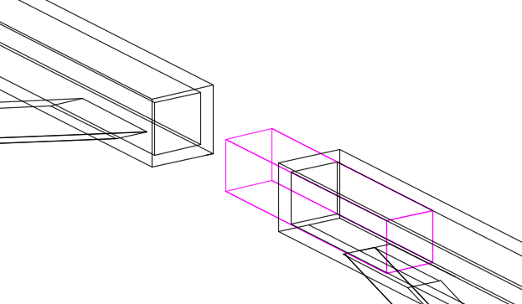
Connections

Slide 19
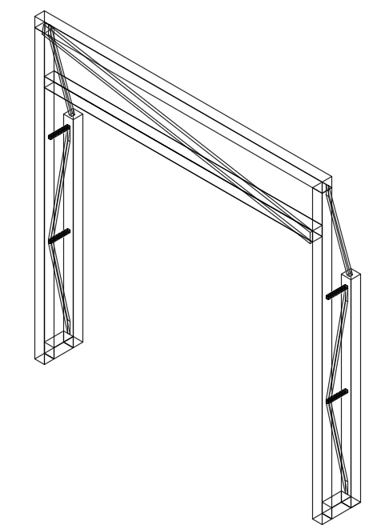
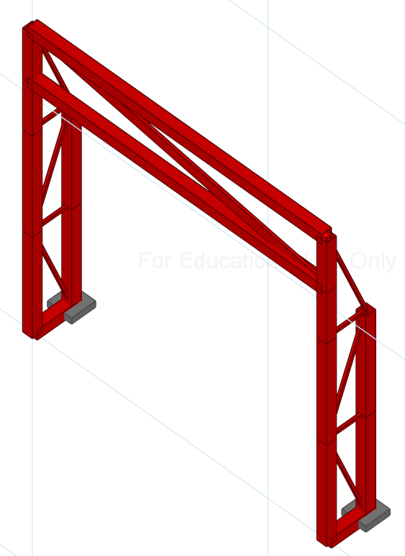
Supports
Notes:
TAKE SNIPS OF SUPPORTS FROM CAD FILES

Slide 20
Fundraising
T & M Associates​
Buck Seifert & Jost Inc.
Garden State Precast
Cruz Concrete
Langan
CHA​
Notes:
So far through our fundraising efforts we have received donations from both T&M Associates, and Buck Seifert & Jost Inc. As of right now we have $1000 dollars of donations. The fundraising process is not over as a few companies donations are still pending making a total of $4500 in donations.

Slide 21
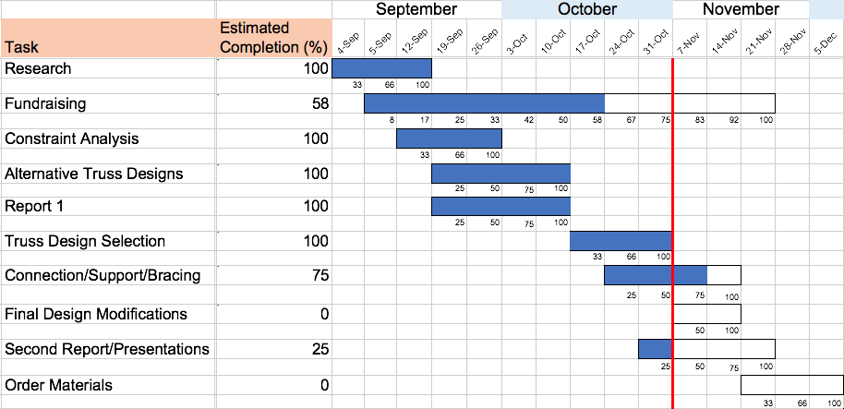
Project Schedule

Slide 22
Estimated Budget
Items | Estimated Cost ($)
Steel Members & Bolts | 2000
Registration | 500
Hotels (2 Rooms) | 600
Transportation to Competition (W/ Tolls) | 100
Presentation Board/Materials | 50
Transportation Box/Jigs/Piers | 50
Fundraising Materials | 75
T-Shirts | 75
Miscellaneous | 150
Total: | 3600

Slide 24
Work Breakdown
Brian
Scheduling, Budget, Decision Matrix, 3D Modeling, Connection Design
Kim
Fundraising, Alternative Truss Design, Site Layout Plan, Constraints
Eric
Alternative Truss Design, Connection Design, 3D Modeling
Sean
Alternative Truss Design, Support Design, Fundraising
Billy
Alternative Truss Design, Lateral Bracing, Decision Matrix

Slide 25
Plans Going Forward
ASCE Steel Bridge Competition
Qualify for nationals
Strand7 (Finite Element Analysis)
Create working drawings
Order materials
Begin fabrication

Slide 26
Questions?

